Slide 1
Data Mining
Yeah, jQuery Mobile #fail
Brian Slezak & Anthony James
Software Developers
The United Methodist Church of the Resurrection
brian.slezak@cor.org | anthony.james@cor.org
@brianslezak | @anthonydjames

Slide 2
Strategic Priorities / Projects
Set annually
Cross-Ministry Teams

Slide 3
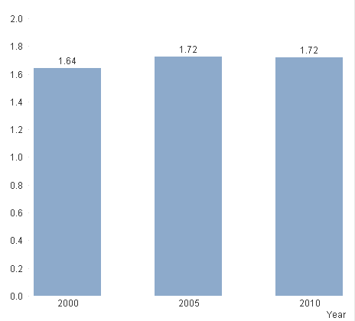
Avg. Attendance (Per Month)

Slide 4
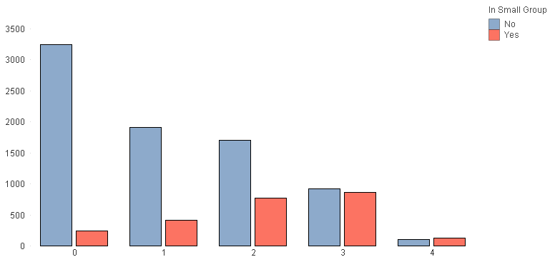
Attendance Per Month by Small Group Participation

Slide 5
Small Group Impact
+82% giving increase per person
+$55 increase per person per year
+70% increase in attendance

Slide 6
Attendance Impact
Increasing attendance from 1.7 times per month to 3 increases giving 67%
Every additional week attended per year increases average per person $33

Slide 7
Attendance + Small Group
Small Group = Yes Attendance = 3 / month +183% increased giving on average
Small Group = No Attendance = 1.25 / month

Slide 8
Attendance + Small Group
Increasing Attendance Rate = Yes Small Group = Yes 100% faster growth in giving rate
Increasing Attendance Rate = No Small Group = Yes

Slide 9
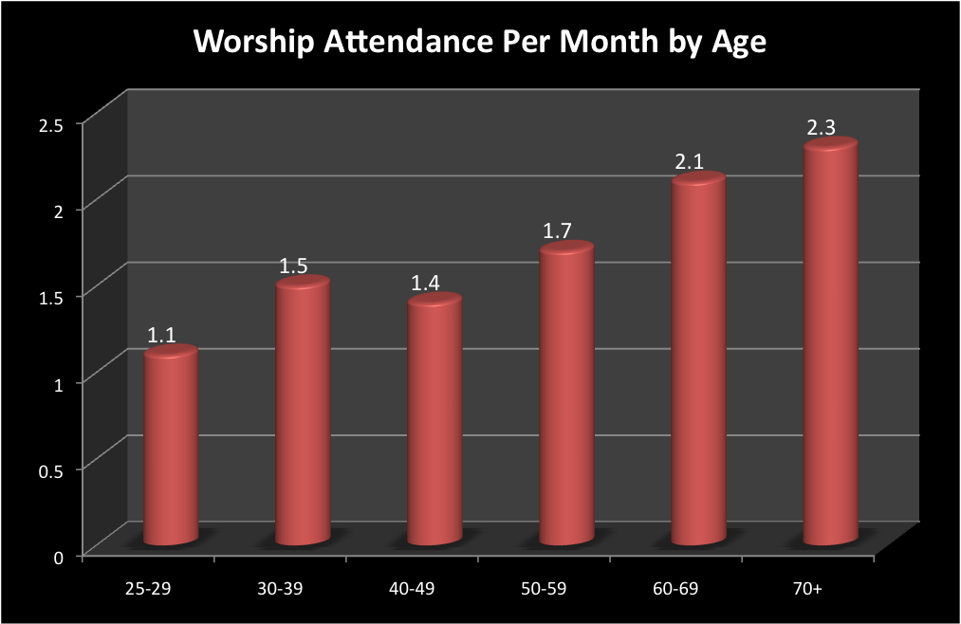

Slide 10
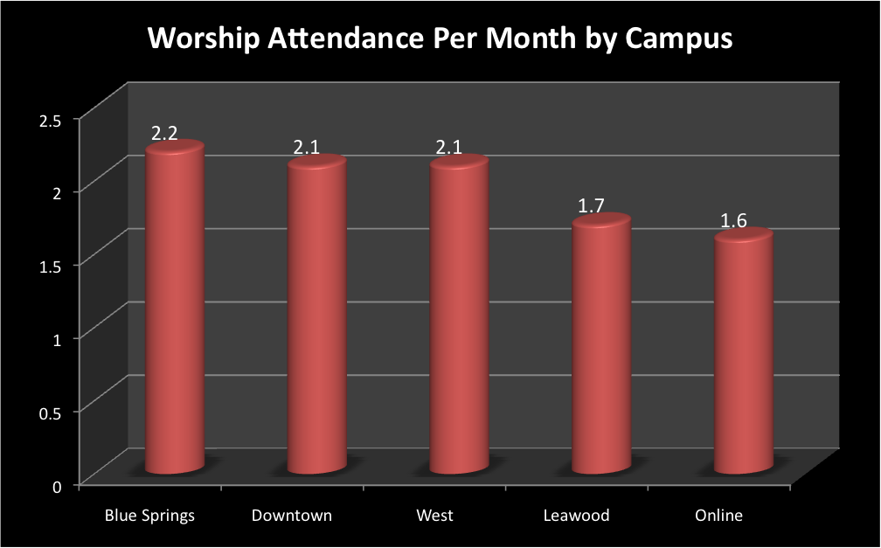

Slide 11
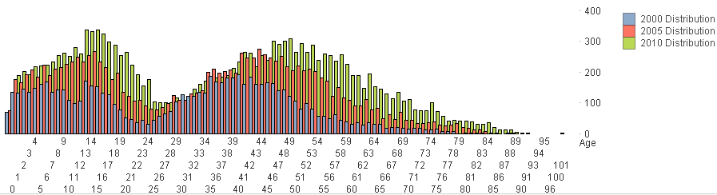
Age Distribution By Year

Slide 12
Data Mining Scripts
Available at http://redmine.cor.org

Slide 13
QlikView
www.qlikview.com
Business Intelligence
Free, yes I said free, version of the tool (Limited to single user, no file sharing)

